Slide 1
Logo Detection and Recognition
Arindam Dutta
Owen Ma
Rafael Iriya
EEE 598 Topic: Computational Image Understanding & Pattern Analysis

Slide 2
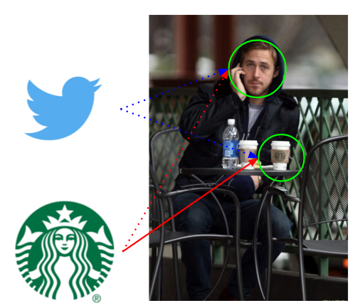
Outline
Motivation
Goal
Challenges
Past work
Proposed work
Initial Results
Division of Work
Questions

Slide 3
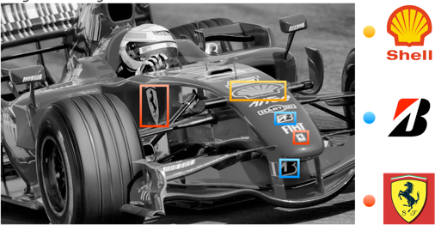
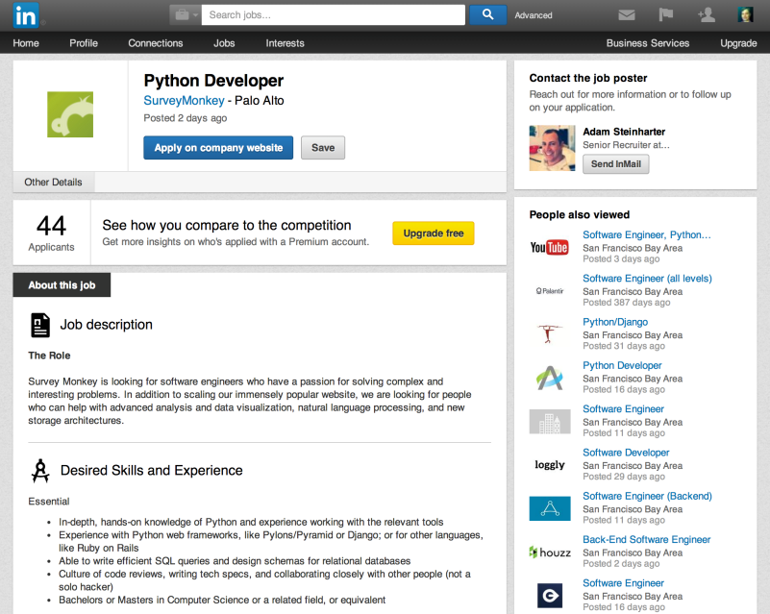



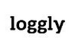

Motivation
The marketing industry invests a large sum of money to place advertisements on billboards, websites, newspapers, banners in events and other items.
How can they measure the value of their products?
In addition to company logos in the document images can be considered as symbols by which the documents can be identified and categorized.

Slide 4
Goal
Build a logo detector and classifier
Publicity statistics
How many logos appear in one image?
How many times does logo appear?
For each appearance
What was the duration? (in case of video)
How big was it?
How visible was it?
How near is it to the focus of attention?
Counterfeit detection
Online estimates of these statistics
GUI model for online estimation

Slide 5
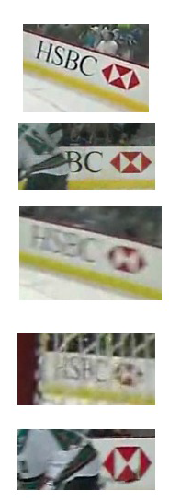
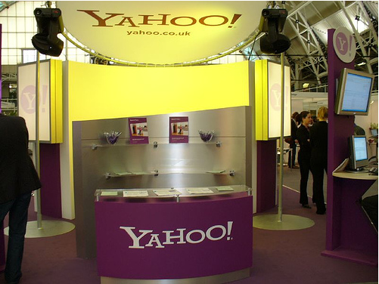
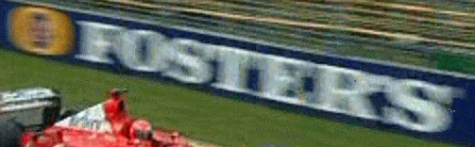
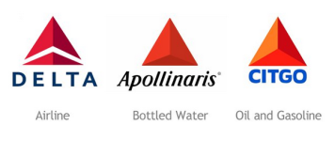
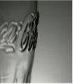
The challenges
Challenges:
Rotation and scaling
Natural outdoor scenes
Unconstrained view angles
Rapid pan-tilt-zoom of cameras
Occlusions
Similar color/texture
Unknown target position, deformations
Same logo appearing twice with different background

Slide 6
Past works
“Scalable Logo Recognition in Real-World Images” by Stefan Romberg, Lluis Garcia Pueyo, Rainer Lienhart, and Roelof van Zwol
SIFT
Find correspondences by building edges
Develop more descriptors for each point
Base matching of logos on triangles
“Logo Detection Application: Extraction, Matching, Segmentation and Classification” by Michele Trevisiol
SURF
Build point correspondences using correlation
Analyzed various search and classification methods

Slide 7
Past works
“Fast Logo Detection and Recognition in Document Images” by Zhe Li, Matthias Schulte-Austum, and Martin Neschen
Build “layers” of binary images and construct connected components
Convex hull features
Orientation matching through “anchor lines”
Segment original image and compare with prototype
“Context Dependent Logo Detection and Recognition Based on Context Dependent Similarity Kernel” by Ch. Divya Susmitha and L. Padmalatha
SIFT, Self similarity, shape context
Matching by “Context-Dependent Kernels for Object Classification” by Hichem Sahbi, Jean-Yves Audibert, and Renaud Keriven
Measure of similarity between points based on similarity to their respective surroundings

Slide 8
Proposed work
Detect known logos
Logo must exist in dictionary
Implement feature extraction techniques that have demonstrated success in the past
Explore our own feature extraction techniques
Compare them
Develop a GUI to package the tool

Slide 9
Initial results
SIFT + RANSAC
nearest to second nearest neighbor is less than 0.8.
RANSAC parameters: Number of iterations for RANSAC: 30
The inlier threshold for RANSAC: 4

Slide 10
Initial results

Slide 11
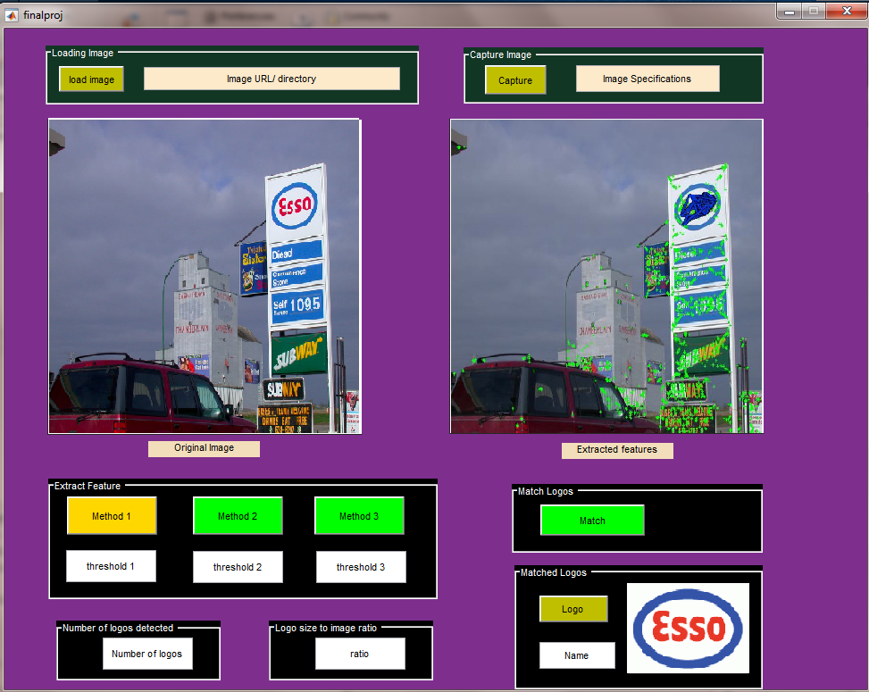
Online GUI

Slide 12



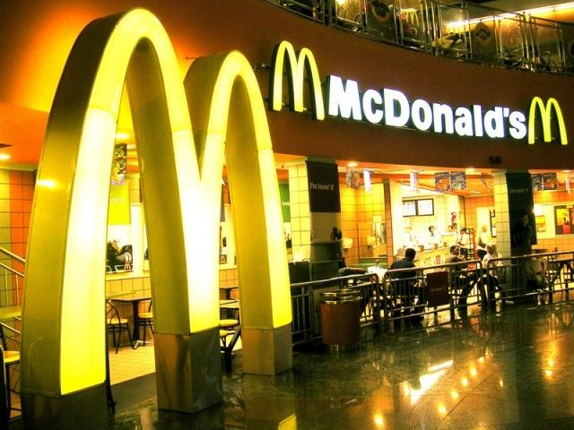
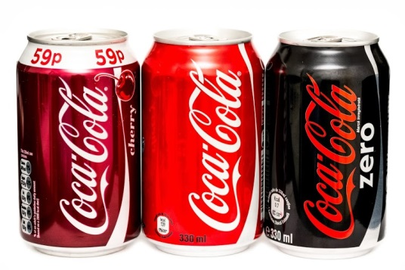
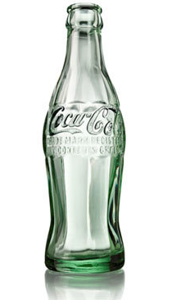
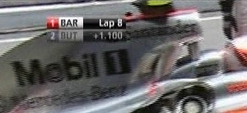
Contributions
Arindam: Similar logo / Fake logo/GUI
Rafael: Rotation/Scaled/Multiple Logos/Color
Owen: Occlusion/Unknown target position, deformations

Slide 13


